Slide 1
SIMATS ENGINEERING,
SAVEETHA INSTITUTE OF MEDICAL AND TECHNICAL SCIENCES
ITA0609 – Machine Learning
CO1-AT3 -TECHNICAL PRESENTATION
Presented by
Monisha .K- 192412296

Slide 2
INTRODUCTION TO MACHINE LEARNING
What is Machine Learning?
Machine Learning is a branch of Artificial Intelligence.
It enables computers to learn from data and experience.
The system identifies patterns and improves its performance.
It can make predictions or decisions without being explicitly programmed for every situation.
Example:
Previous Emails → Learning → Spam / Not Spam

Slide 3
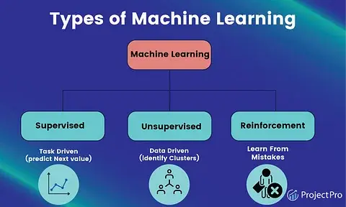
TYPES OF LEARNING PROBLEMS
Main Types of Machine Learning
1. Supervised Learning
Learns from labelled data.
The correct output is already known.
Example: Disease prediction and spam detection.
2. Unsupervised Learning
Learns from unlabelled data.
Finds hidden patterns or groups.
Example: Customer grouping.
3. Reinforcement Learning
Learns through trial and error.
Uses rewards for correct actions and penalties for incorrect actions.
Example: Robot learning and game-playing AI.

Slide 4
PERSPECTIVES OF MACHINE LEARNING
1. Symbolic Approach
Uses rules, logic and symbols.
Knowledge is represented in an understandable form.
Example: IF temperature is high → THEN turn ON the fan
2. Statistical Approach
Uses data, probability and mathematical models.
Finds patterns from large amounts of data.
Example: Disease prediction using patient data.

Slide 5
IMPORTANT ISSUES IN MACHINE LEARNING
1. Data Quality
Incorrect, incomplete or noisy data affects learning.
Poor data can produce incorrect predictions.
2. Overfitting
The model memorizes training data.
It performs well on training data but poorly on new data.
3. Computational Complexity
Complex models and large datasets require more:
Processing time
Memory
Computational power

Slide 6
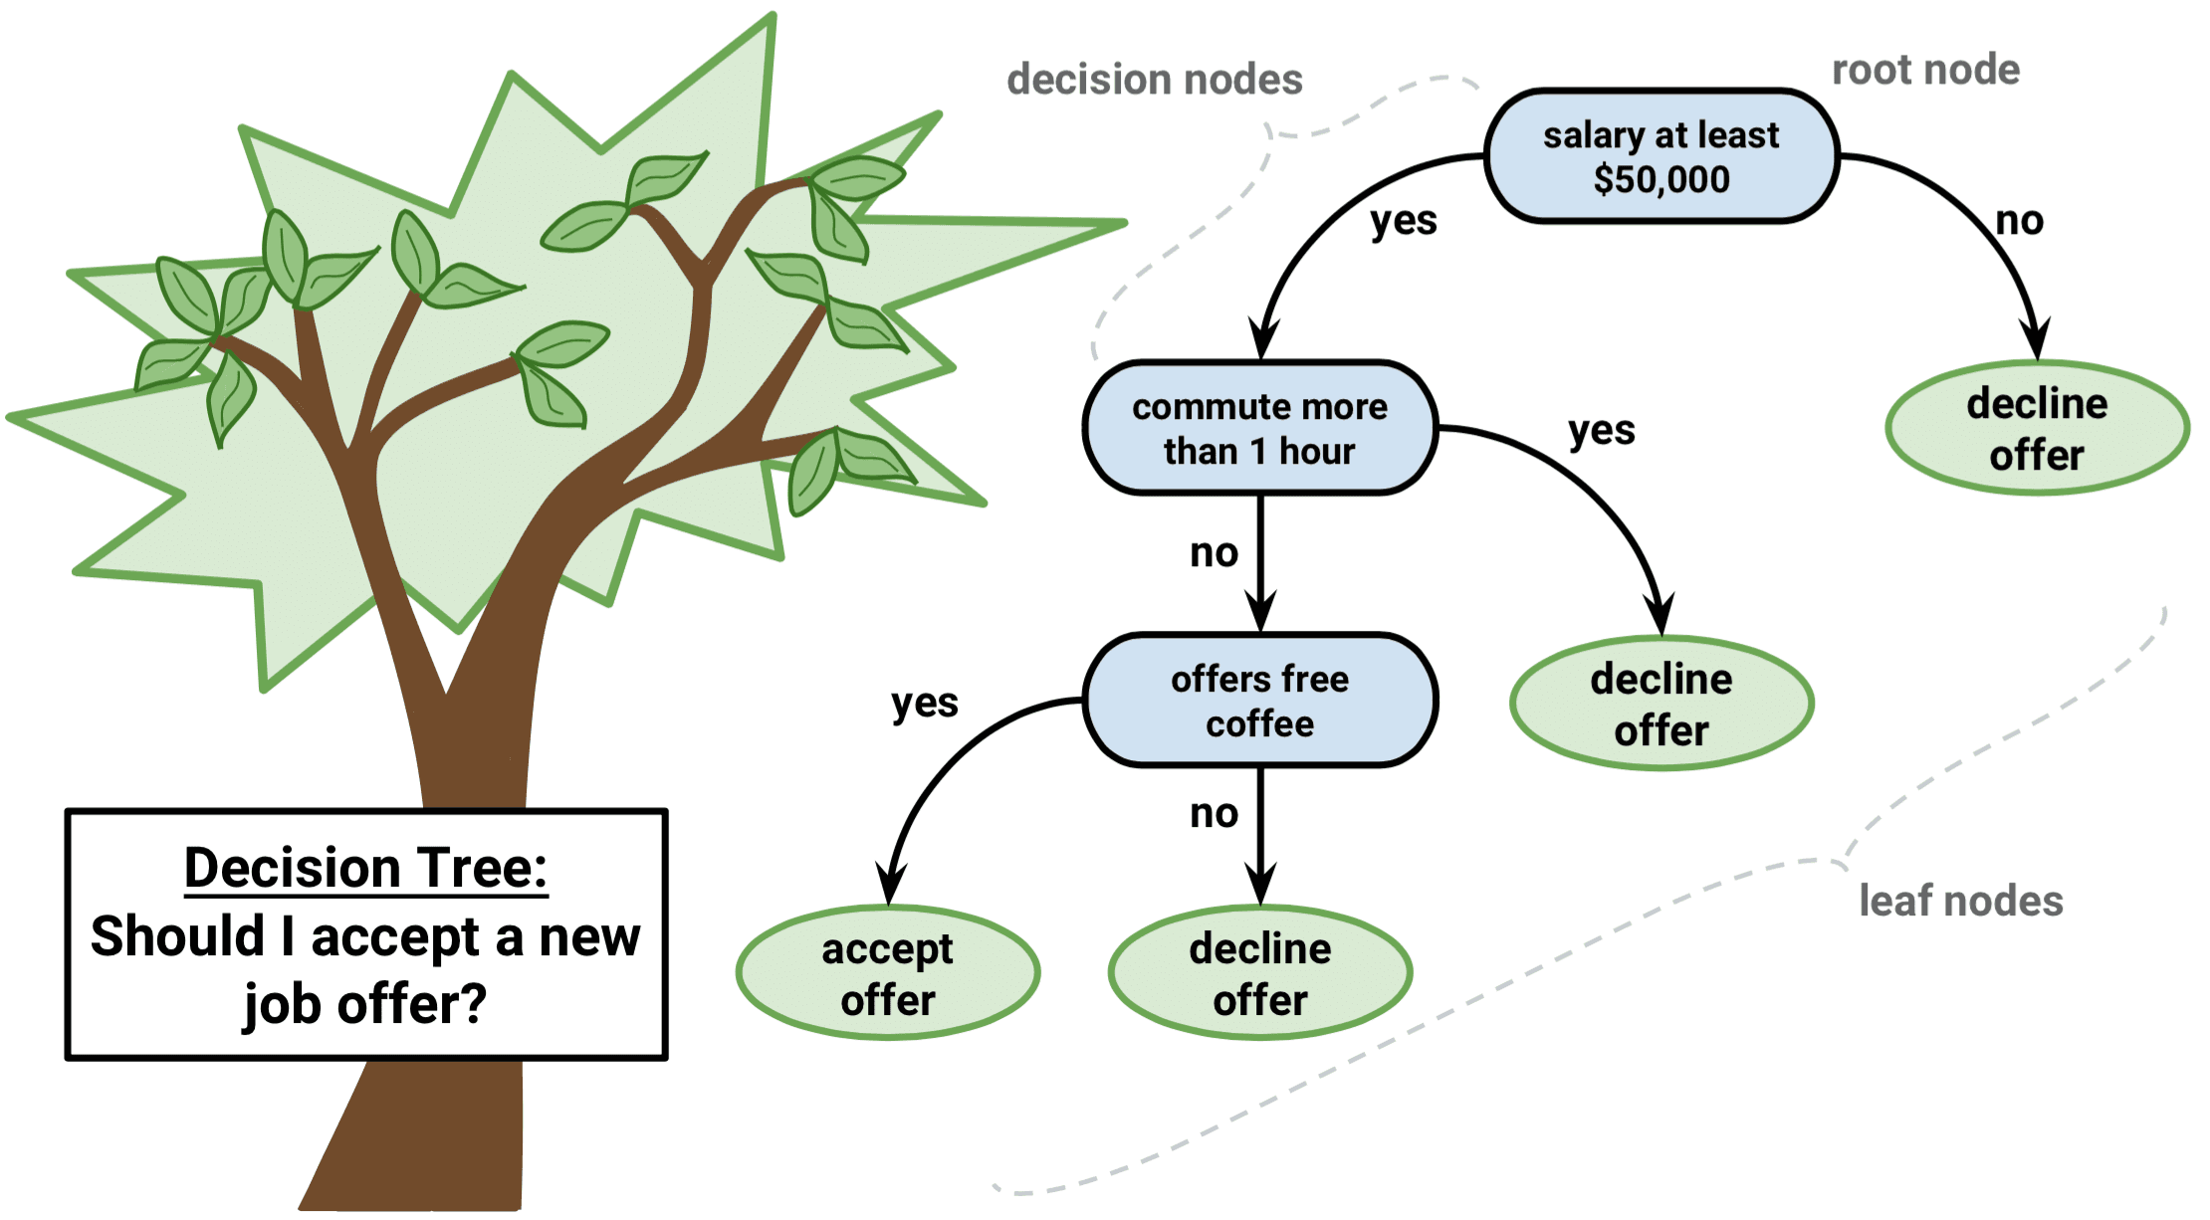
DECISION TREE LEARNING
What is a Decision Tree?
A Decision Tree is a tree-like machine learning model.
It is used for classification and decision-making.
It divides data using a series of questions or decisions.
Main Components
Root Node: First decision or question.
Branches: Possible outcomes.
Leaf Node: Final decision or prediction.

Slide 7
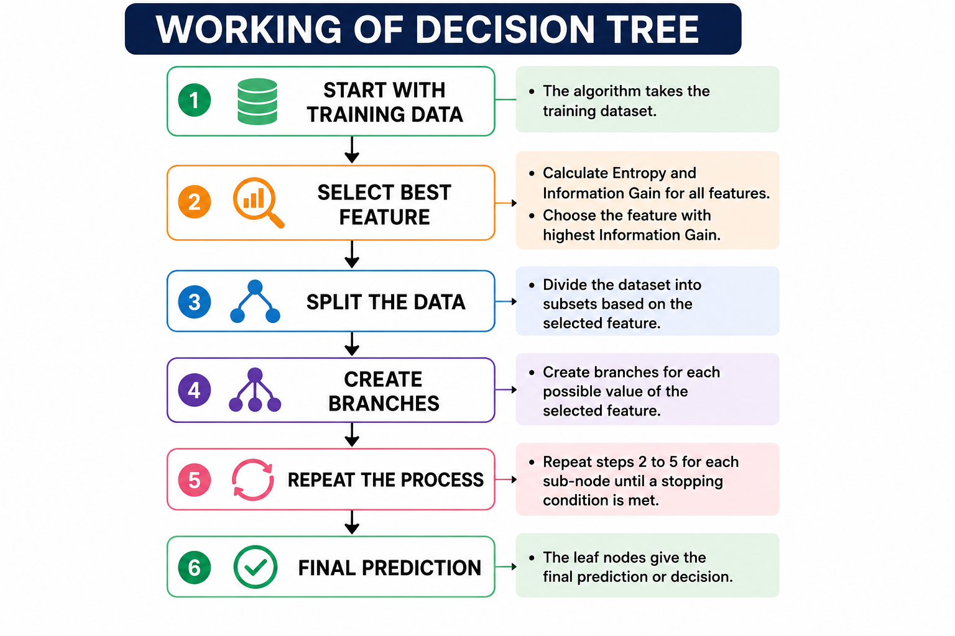
WORKING OF DECISION TREE LEARNING
Steps:
Start with the training data.
Select the best feature for splitting.
Divide the data into branches.
Continue splitting if required.
Stop when a final decision is reached.
Key Point:
The best feature is selected using Entropy and Information Gain.

Slide 8
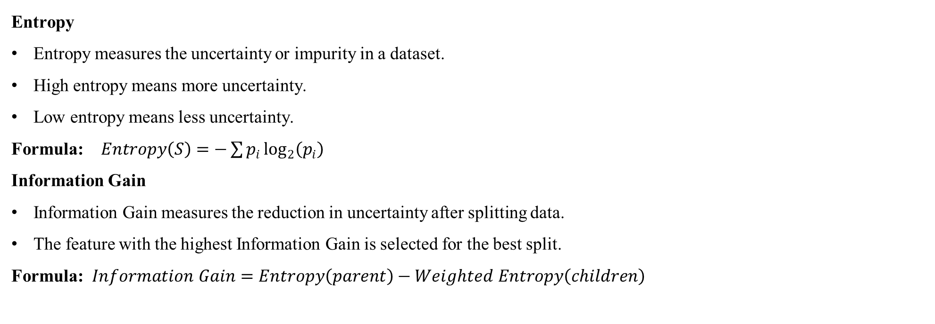
ENTROPY AND INFORMATION GAIN
Entropy
Entropy measures the uncertainty or impurity in a dataset.
High entropy means more uncertainty.
Low entropy means less uncertainty.
Formula: $Entropy\left(S\right)=−\sum{p_{i}}\log_{2}\left(p_{i}\right)$
Information Gain
Information Gain measures the reduction in uncertainty after splitting data.
The feature with the highest Information Gain is selected for the best split.
Formula: $Information Gain=Entropy\left(parent\right)−Weighted Entropy\left(children\right)$

Slide 9
TREE PRUNING
What is Pruning?
Pruning is the process of removing unnecessary branches from a decision tree.
It helps to reduce overfitting.
It makes the tree simpler and easier to understand.
Benefits of Pruning
Reduces overfitting.
Improves performance on new data.
Reduces model complexity.
Makes the tree easier to interpret

Slide 10
ADVANTAGES, LIMITATIONS AND APPLICATIONS
Advantages
Easy to understand and interpret.
Easy to visualize.
Useful for classification and decision-making.
Requires less data preparation.
Limitations
Can suffer from overfitting.
Large trees can become complex.
Small changes in data may change the tree structure.
Applications
Healthcare: Disease prediction
Banking: Loan approval
Email: Spam detection
Business: Customer classification

Slide 11
CONCLUSION
Machine Learning enables computers to learn from data.
Supervised, Unsupervised and Reinforcement Learning solve different learning problems.
Symbolic approaches use rules and logic.
Statistical approaches use data and probability.
Data quality, overfitting and computational complexity affect ML performance.
Decision Trees represent knowledge using roots, branches and leaves.
Entropy and Information Gain help select the best feature. Pruning reduces unnecessary complexity and overfitting.

Slide 12


